Slide 1
Mastering Blockchain Third Edition
Chapter 14, Development Tools and Frameworks

Slide 2
Outline
Languages
Compilers
Tools and libraries
Frameworks
Contract development and deployment
The Solidity language

Slide 3
Taxonomy of Ethereum development ecosystem components

Slide 4
Languages
Solidity
Vyper
Yul
Mutan
LLL
Serpent
Read more about Solidity and DApp development resources here:
http://ethdocs.org/en/latest/contracts-and-transactions/developer-tools.html#developer-tools

Slide 5
Compilers
The Solidity compiler (solc)
Compiler used to compile smart contract code and convert it into bytecode

Slide 6
Tools and libraries
Ganache
Simulated personal Ethereum blockchain with a user interface (UI), commonly used for development and testing purposes
Ganache-cli
Command-line version of Ganache
Require NodeJS as a pre-requisite

Slide 7
Frameworks
Truffle
Development framework for Ethereum
Features for deployment, testing and debugging

Slide 8
Drizzle
A set of frontend libraries for the development of web UIs
Makes frontend development for DApps easier
Requires NodeJS
Based on the Redux store
Maintains a library of React components

Slide 9
Other tools
Embark: powerful developer platform for building and deploying DApps
Brownie: framework for Ethereum smart contract development and testing
Waffle: another framework for smart contract development and testing
Etherlime: framework that allows DApp development, debugging, testing, and testing in Solidity and Vyper
OpenZeppelin: a toolkit for smart contract development

Slide 10
Contract development and deployment
Writing smart contracts is concerned with writing the contract source code in Solidity in a text editor.
There are various plugins and add-ons available for Vim in Linux, Atom, and other editors that provide syntax highlighting and formatting for Solidity source code.

Slide 11
The layout of a Solidity source code file

Slide 12
The Solidity language
A Domain-Specific Language (DSL)
Contract-oriented language
JavaScript / C-like
Widely used
Statically typed

Slide 13
Variables
Local variables
Global variables
State variables
Private
Public
Internal

Slide 14
Data types
Value types and reference types
The EVM can read and write data in different locations.
Stack
Calldata
Memory
Storage
Code
Logs

Slide 15
Value types
Boolean
Integers
Address
Literals
Integer literals
String literals
Hexadecimal literals
Enums

Slide 16
Reference types
Arrays
Structs
Mappings

Slide 17
Control structures
If
Do
While
For, break, and continue
Return

Slide 18
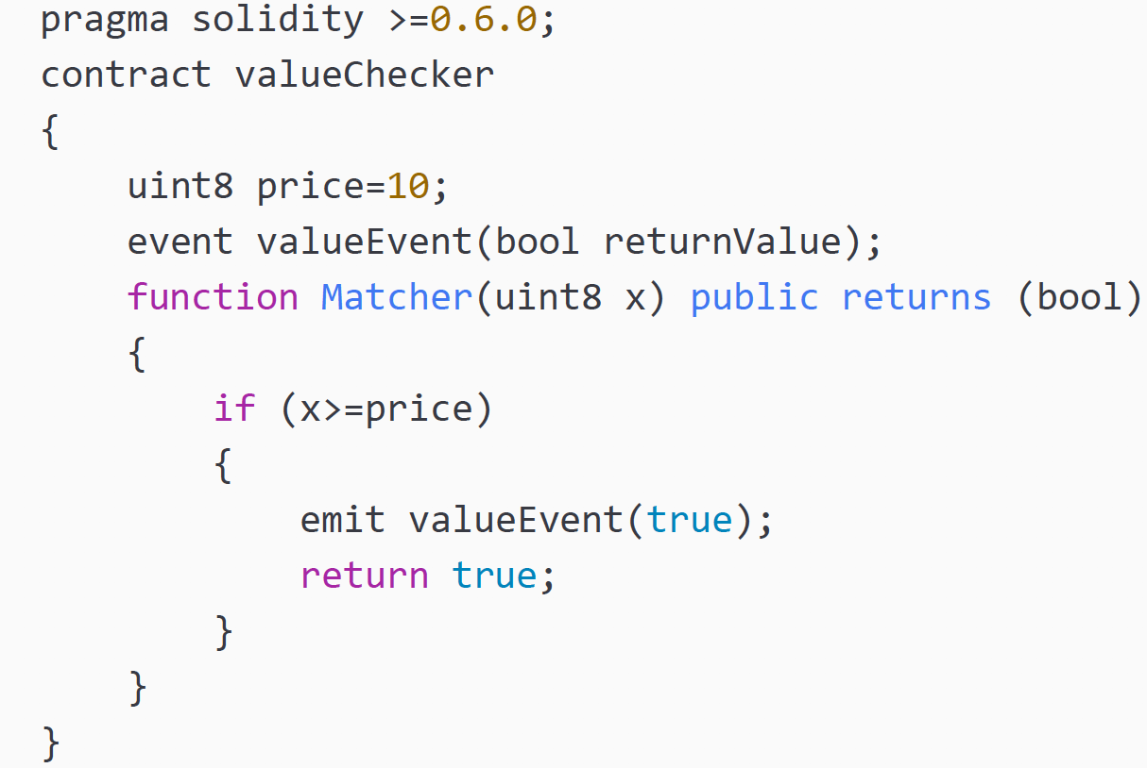
Events
Events are triggered against an action
First events are declared then emitted

Slide 19
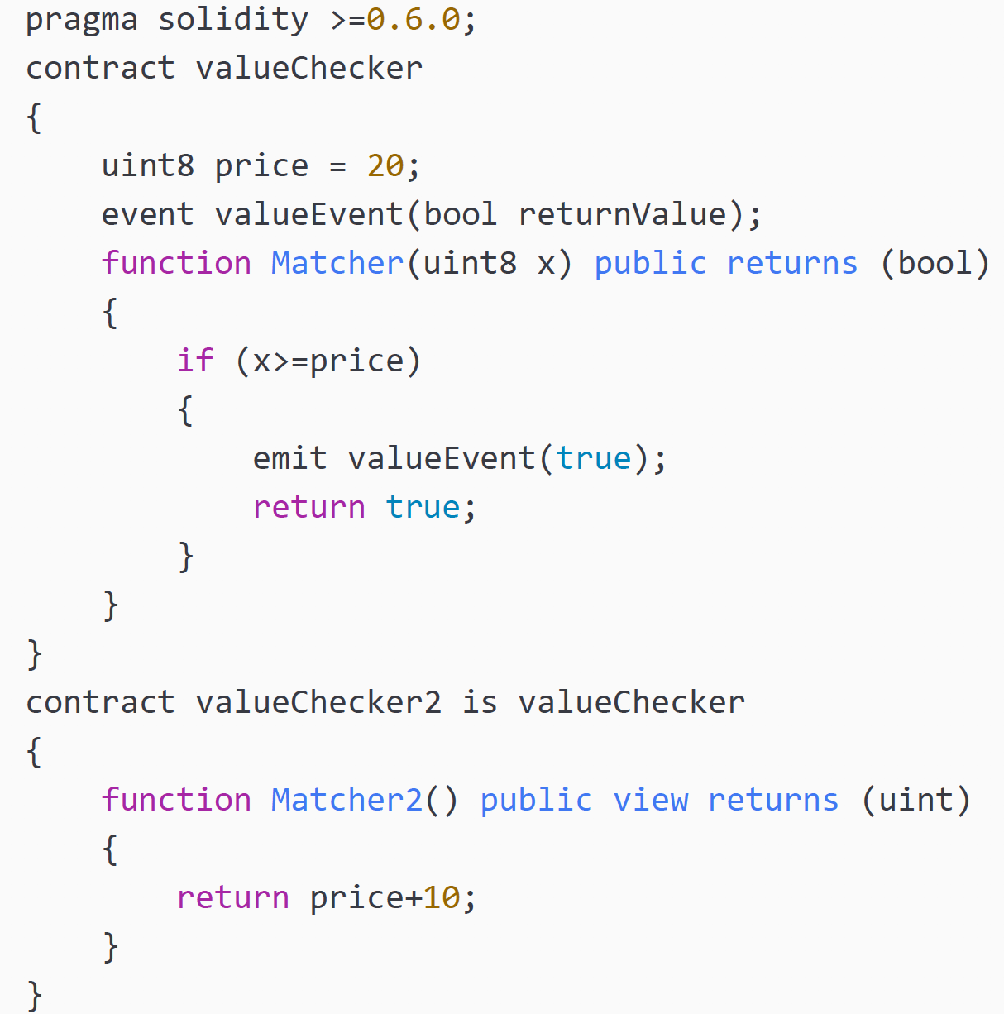
Inheritance
A mechanism used to extend functionality of a contract, by allowing a new contract to be derived from another contract.

Slide 20
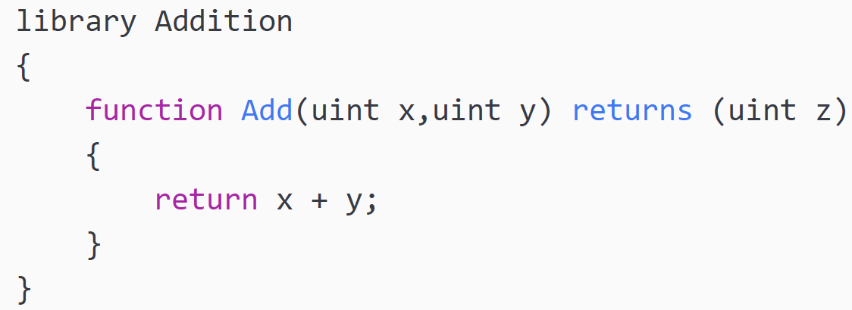
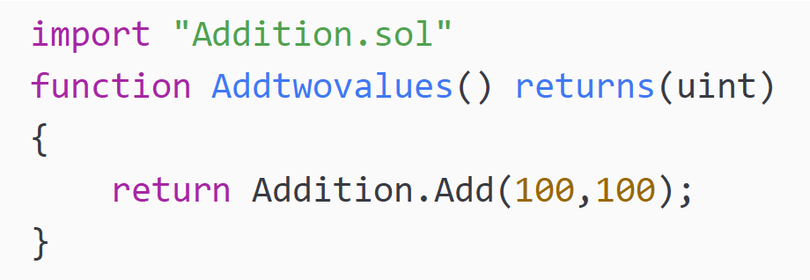
Libraries
Similar to contracts, but they are intended for code re-use. For example, the library Addition imported in another contract allows the Add function to be re-used

Slide 21
Functions
Internal functions
External functions
Declaration of a function:

Slide 22
Functions
Fallback functions
Modifier functions
Constructor function
Function visibility specifiers
External
Public
Internal
Private

Slide 23
Function modifiers
Pure: This modifier prohibits access or modification to state.
View: This modifier disables any modification to state.
Payable: This modifier allows payment of ether with a call.
Constant: This modifier disallows access or modification to state. This is available before version 0.5.0 of Solidity.

Slide 24
Error handling
Assert
Require
Revert
Try/Catch
Throw

Slide 25
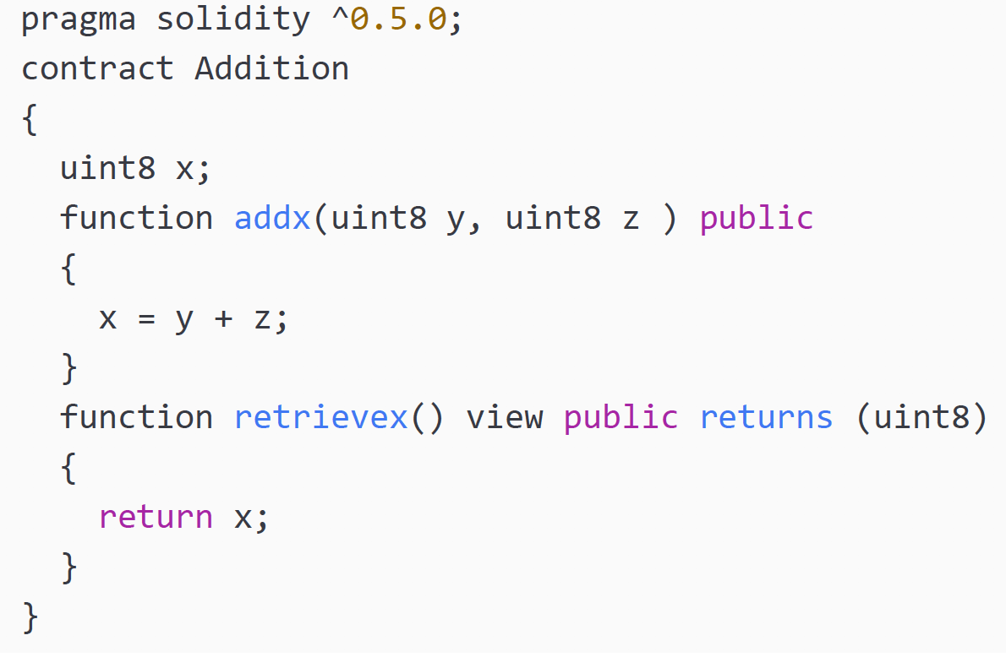
Exercise
Provide a gas estimate of the following contract:

Slide 26
Summary
In this presentation, we covered:
An introduction to development tools for Ethereum, such as Ganache CLI.
Ganache
Frameworks such as Truffle
Drizzle
Solidity concepts, such as value types, reference types, functions, and error handling concepts.
We also considered writing contracts using Solidity.

